Slide 1
3D Furniture Showroom:
In OpenGL 3.3
Course No: CSE 4208
Course Name: Computer Graphics Laboratory
Presented By:
Nishat Tasnim Sithy
Roll: 1807033
Year: 4th
Semester: 2nd

Slide 2
Contents
Introduction
Features
Conclusion

Slide 3
Introduction
A two-storied furniture showroom designed using OpenGL 3.3.
OpenGL 3.3 uses Shader-Based architecture
Exclusively programmable pipeline

Slide 4
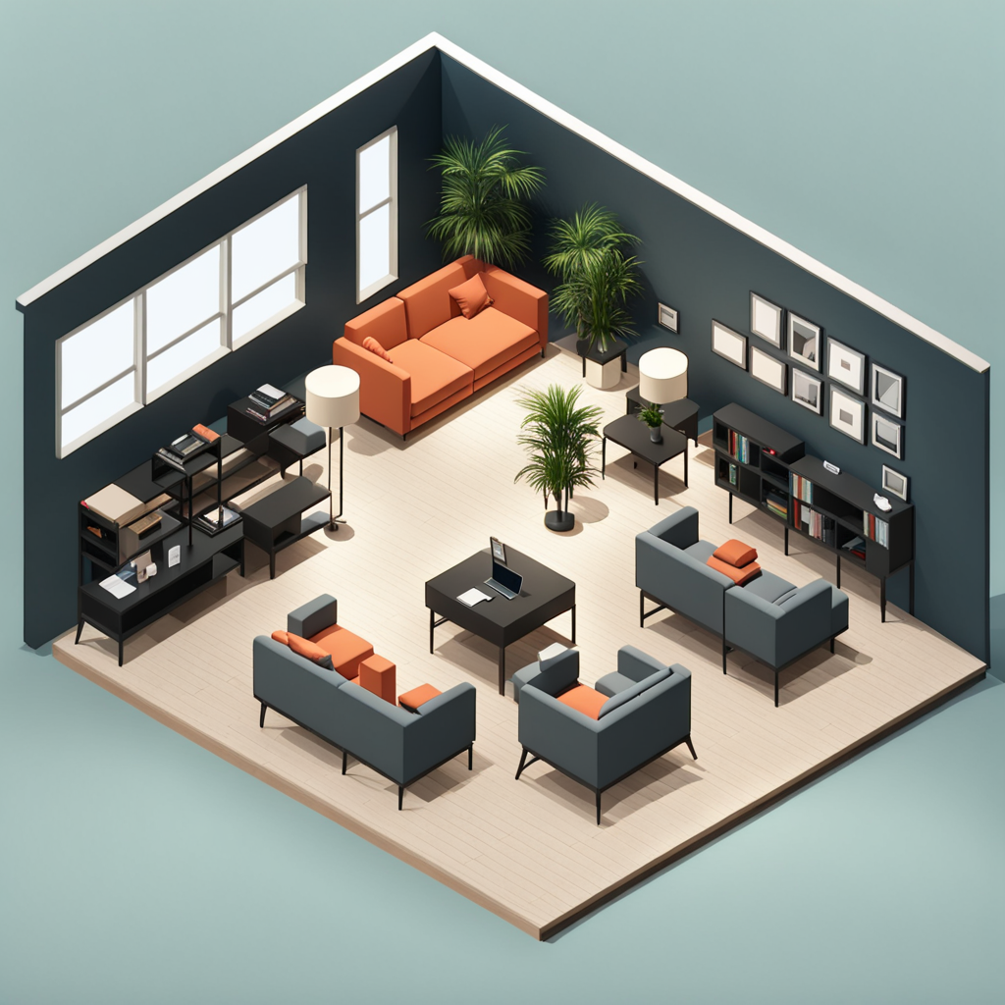
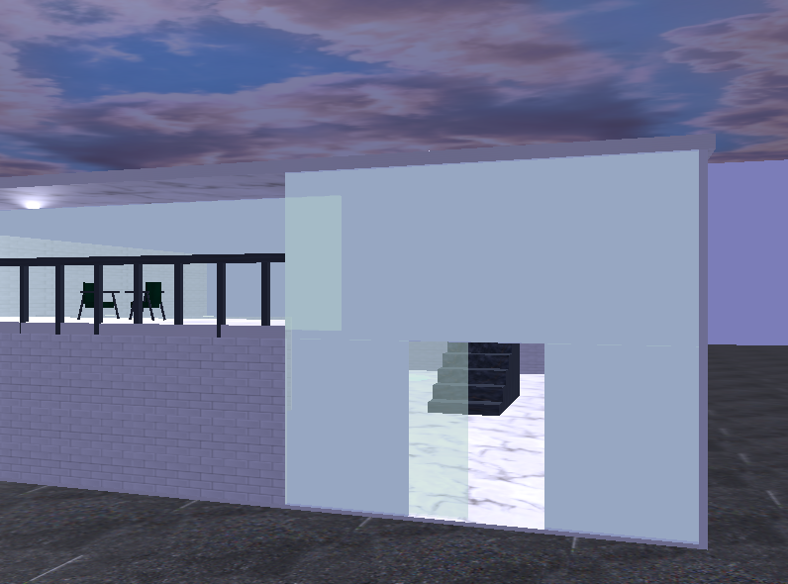
Objective
A two-storied furniture showroom
Complex object of multiple geometric shape
Making dynamic objects
Figure 1.1: Inspiration
Figure 1.2: Accomplishment

Slide 5
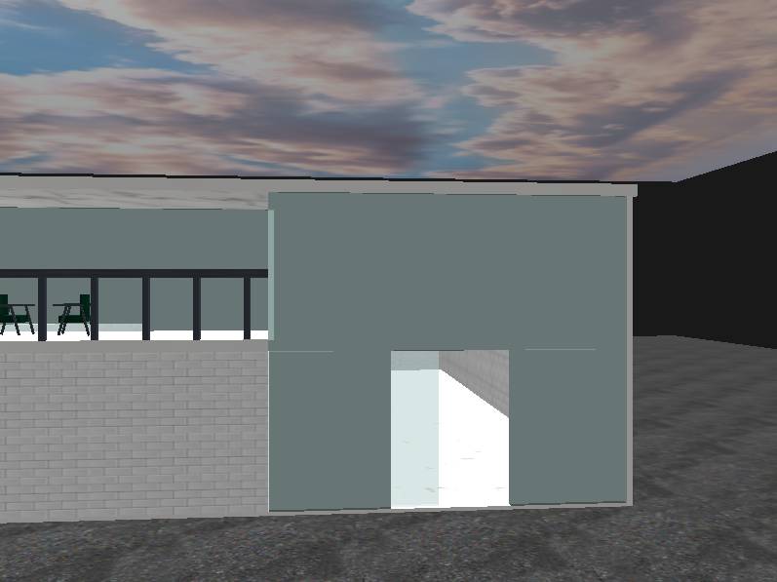
Features
Door opens at entry point by pressing Key “L”
Figure 1.3: Door to furniture showroom

Slide 6
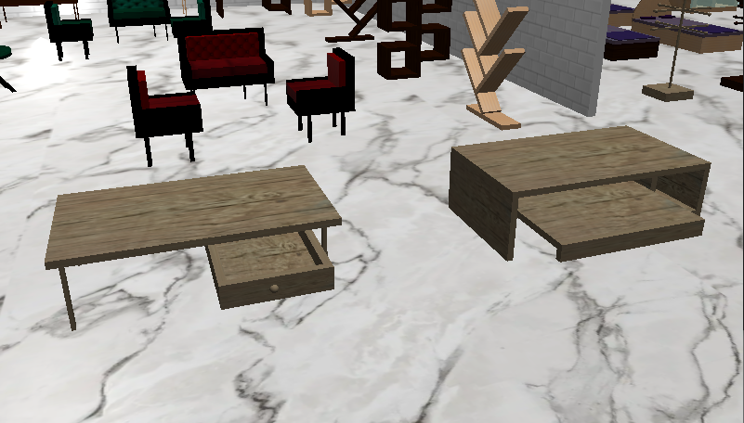
Features (cnt’d)
Drawer opens at these tables by pressing Key “M” and “N”
Figure 1.4: Study table and Computer table with sliding drawer

Slide 7
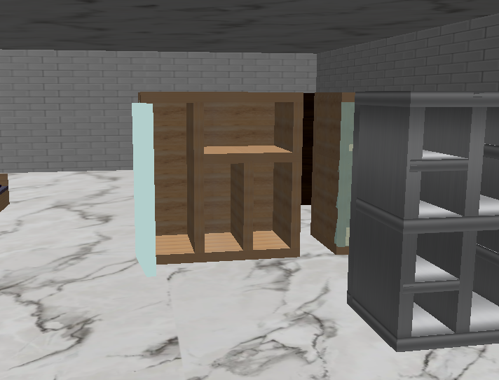
Features (cnt’d)
The Wardrobe door opens by pressing Key “O”
Figure 1.5: Opening of wardrobe

Slide 8
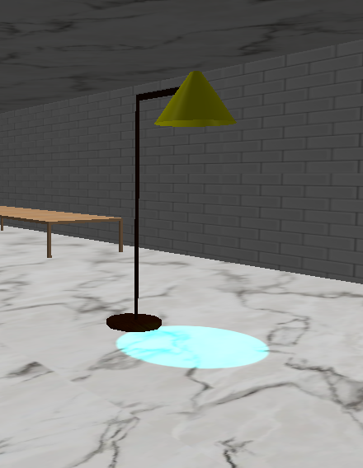
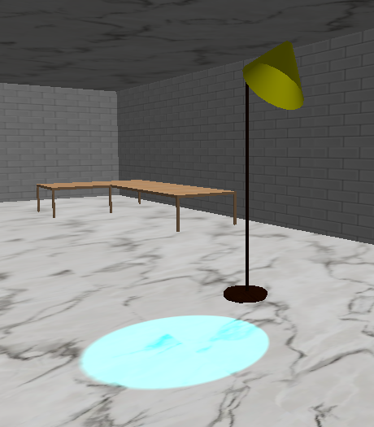
Features (cnt’d)
The lampshade rotates by pressing key “U” and “P”
Figure 1.7: Lampshade
Figure 1.6: Lampshade

Slide 9
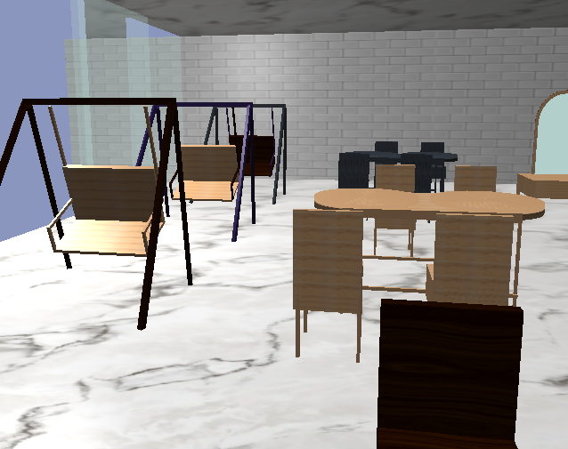
Features (cnt’d)
The swings moves automatically
Figure 1.7: Swing

Slide 10
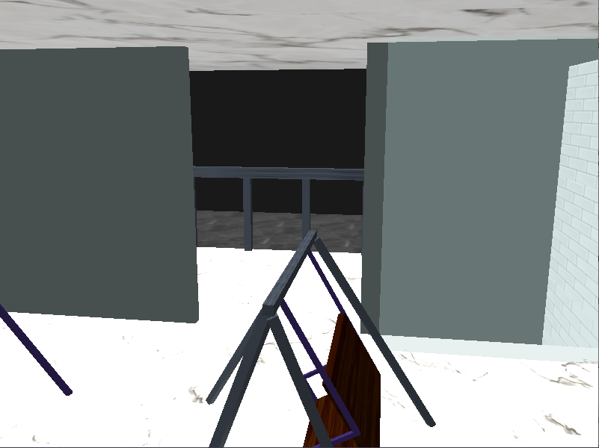
Features (cnt’d)
The door to balcony opens by pressing key “K”
Figure 1.8: Balcony door opening

Slide 11
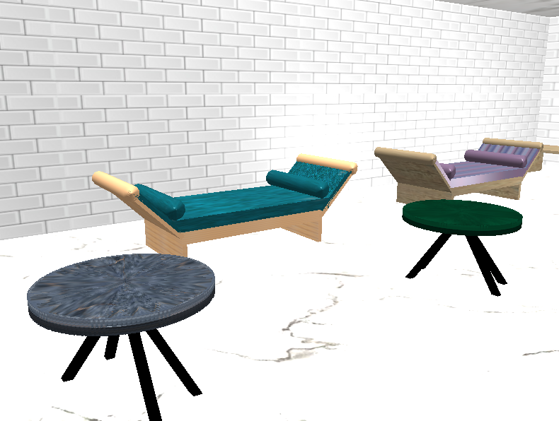
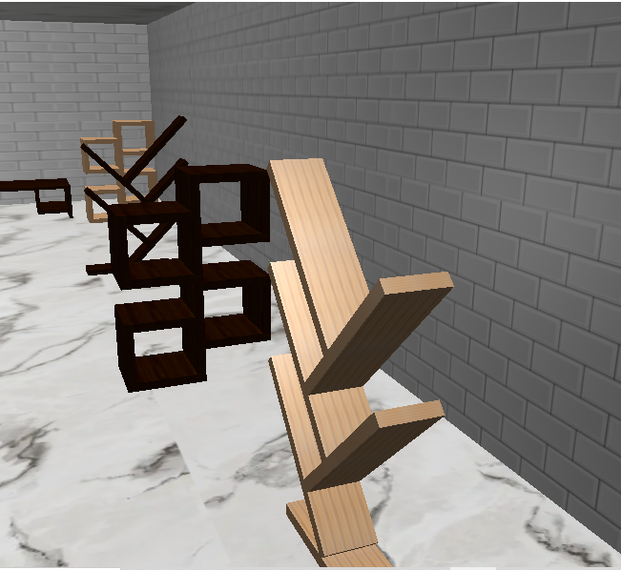
Features (cnt’d)
Other objects
Figure 1.9: Divans and Tea-table using Cylinder
Figure 1.10: Bookshelves

Slide 12
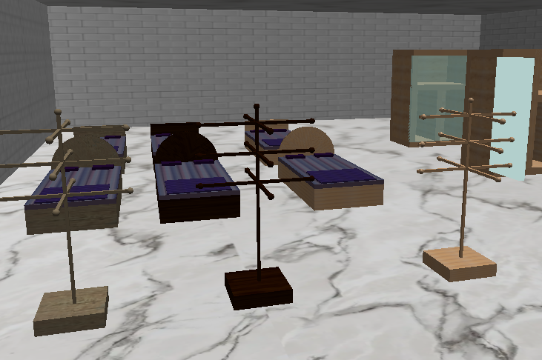
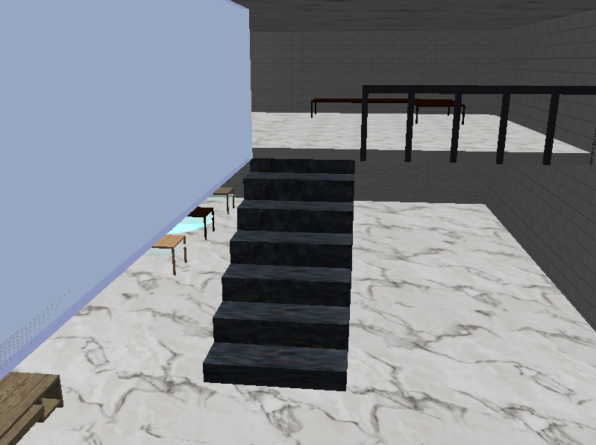
Features (cnt’d)
Other objects
Figure 1.12: Bed and Coat Hanger using Cylinder, Spheres and Cube
Figure 1.13: Stairs to second floor

Slide 13
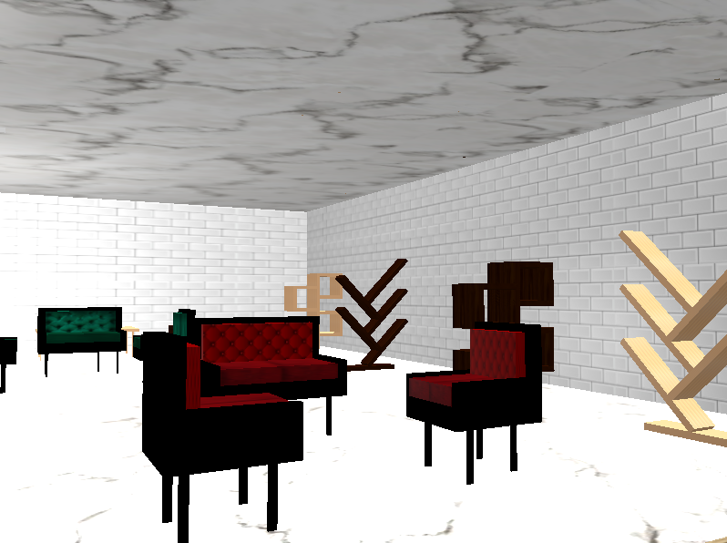
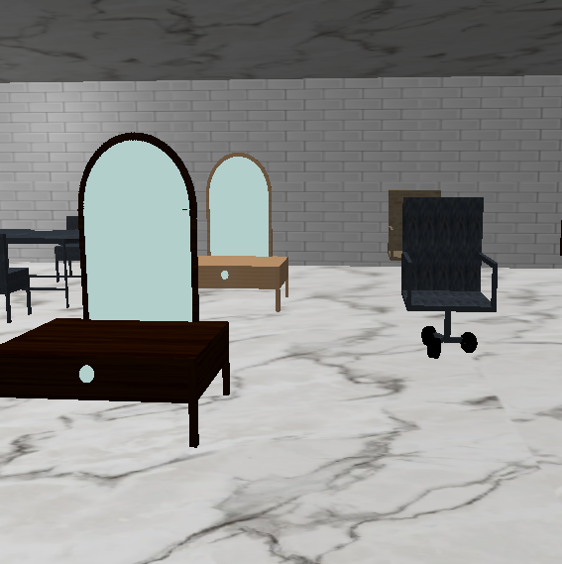
Features (cnt’d)
Other objects
Figure 1.14: Sofa
Figure 1.15: Dressing Table

Slide 14
Conclusion
Two shaders were used to render texture and lighting.
All the objects were designed , no readymade model has been used.
2D texture has been mapped on 3D objects to make it appear realistic.

Slide 16
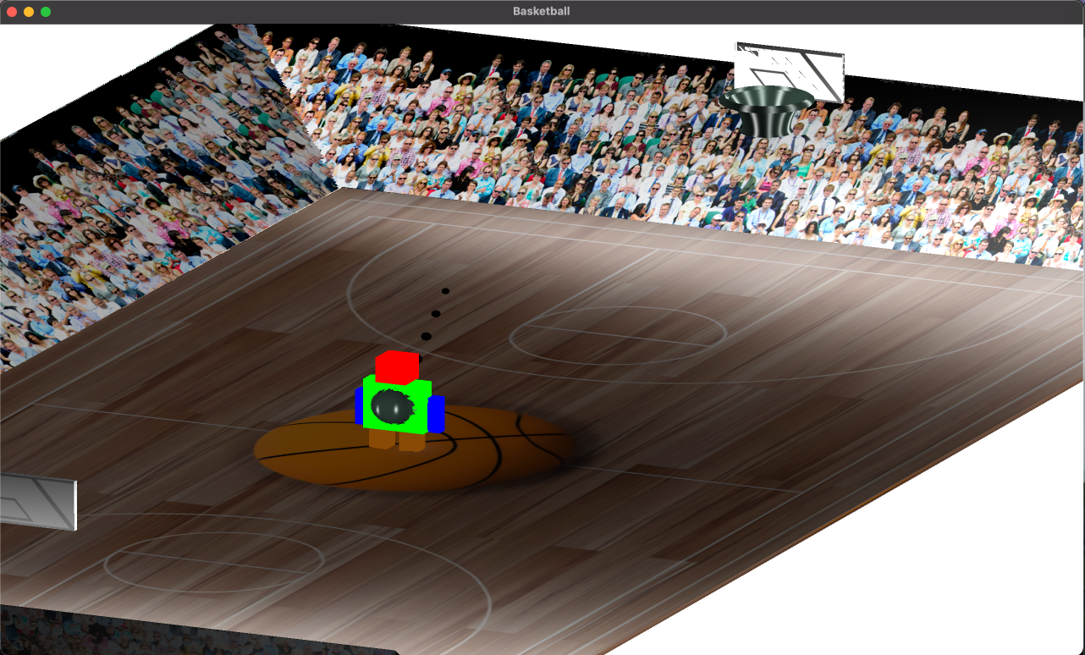

Slide 17
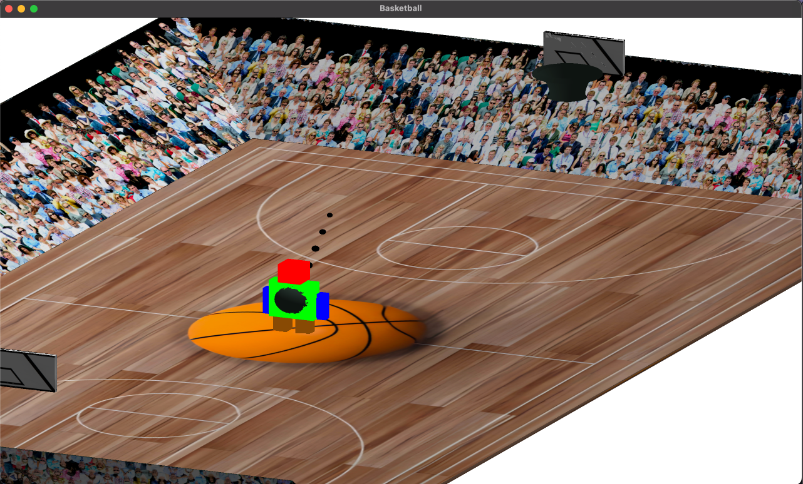

Slide 18
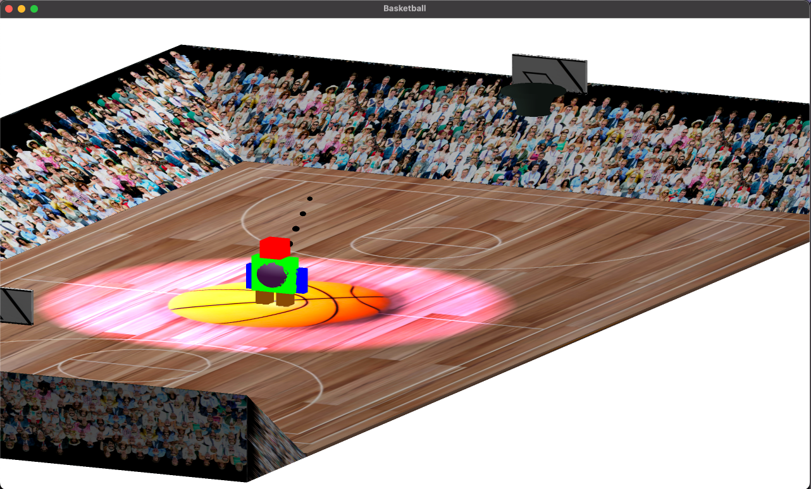

Slide 19
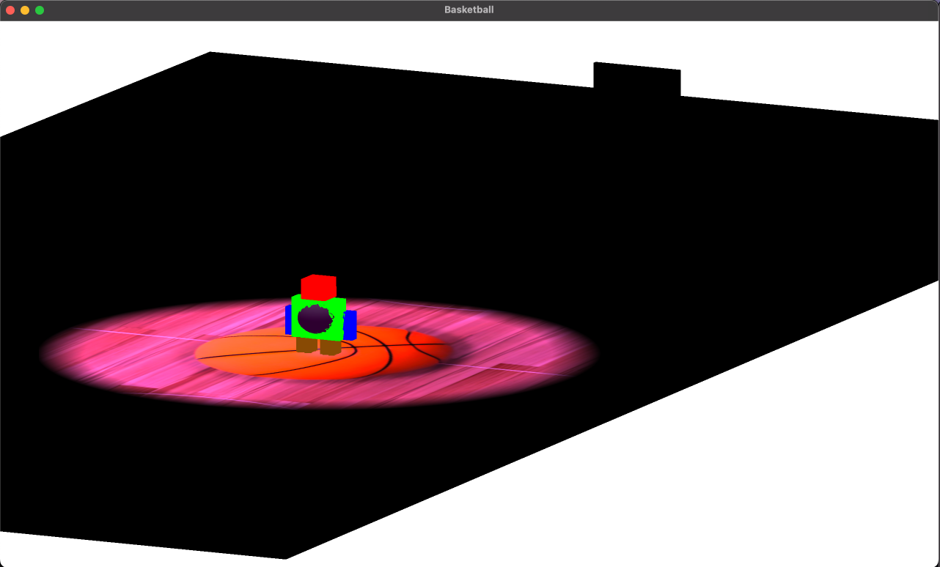

Slide 20
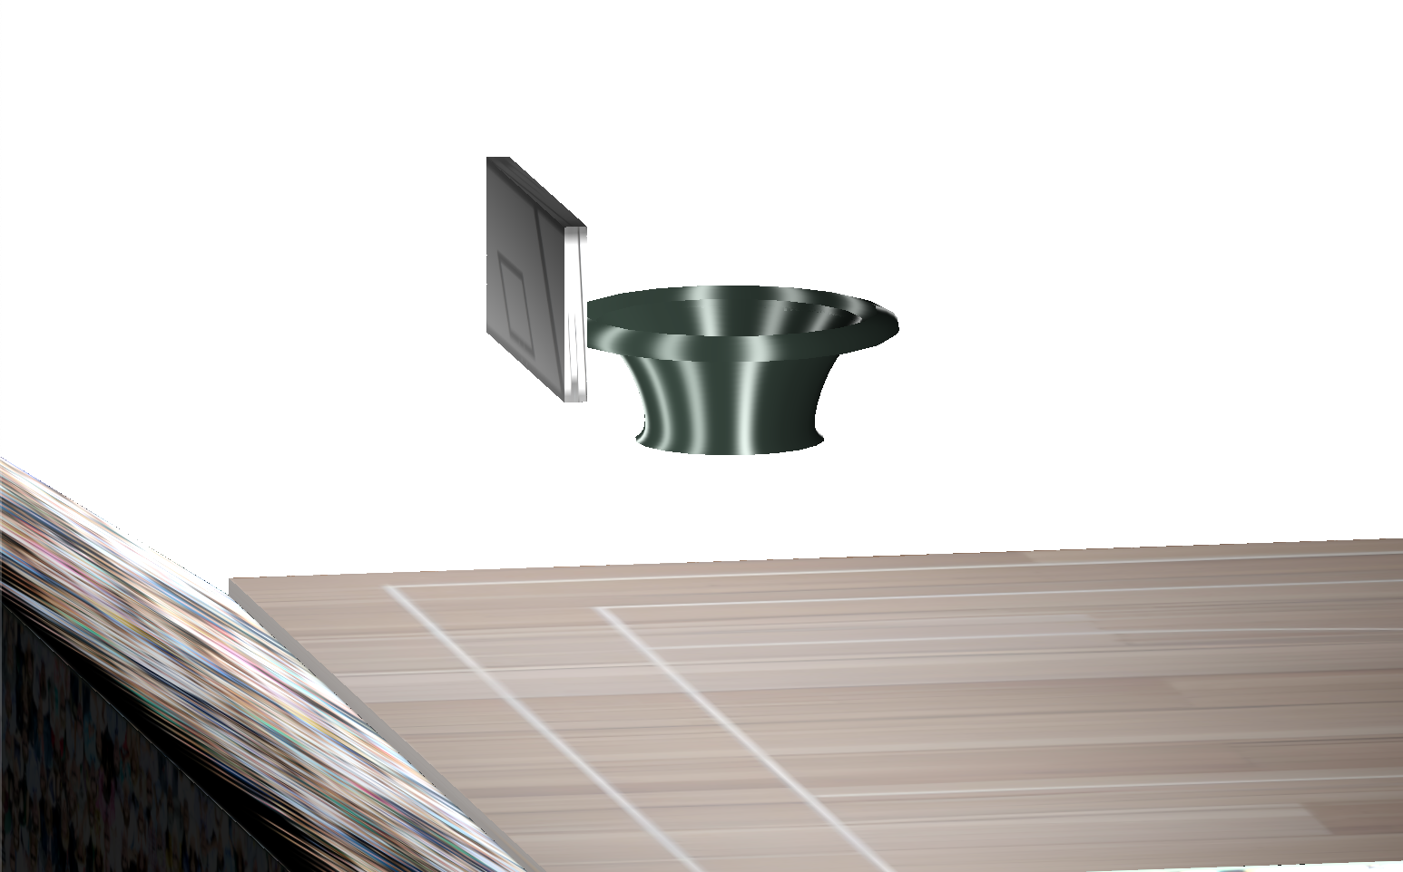

Slide 21
